Slide 1
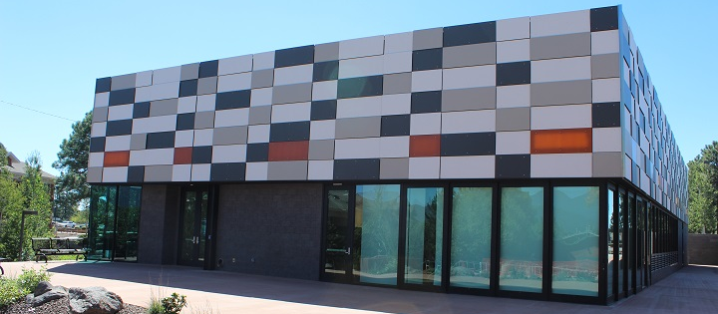

NAU International pavilion expansion
CENE Capstone UGRADS Presentation
December 9, 2016
Synergy Engineering
Abdulaziz Alajmi, Phoo Myat Sandy Maung, Yijie Gao, Yang Ding

Slide 2
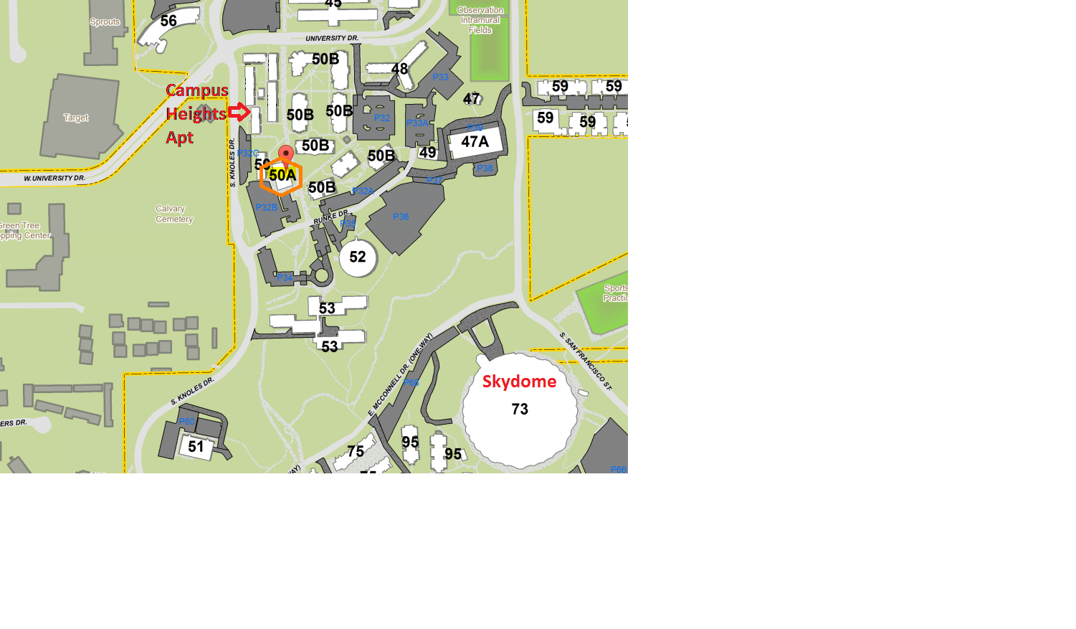
Project Background
Synergy Engineering
NAU International Pavilion: a dynamic event destination
The existing building is smaller than the proposed one
An additional 15,000 square feet building adjacent to the existing one
N
Figure 1: NAU Campus Map
Notes:
The current building is smaller then what was originally proposed and built and they would like to see a design for a full 2-story traditional building.

Slide 3
Project Client, Technical Advisors, and Stakeholders
Synergy Engineering
Client
  Meyer Borgman Johnson Engineering
Technical Advisors
  Dr. Robin Tuchscherer
  Professor Kaikea Kaoni
Stakeholders
  Meyer Borgman Johnson Engineering
  Arizona Board of Regents
  NAU
  NAU students
  Residents near the expansion
  Technical advisors

Slide 4
Project Schedule
Name | Begin Date | End Date
Task 1.0 Site Selection | 08/29/2016 | 09/05/2016
Task 2.0 Surveying | 09/06/2016 | 09/09/2016
Task 3.0 Design Documents Review | 09/06/2016 | 09/09/2016
Task 4.0 Structural Design | 09/16/2016 | 11/25/2016
Task 4.1 Building Layout Options | 09/16/2016 | 09/23/2016
Task 4.2 Framing Plan and Details | 09/26/2016 | 10/29/2016
Task 4.3 Civil Site Plan | 10/30/2016 | 11/08/2016
Task 4.4 Foundation Plan and Details | 11/09/2016 | 11/25/2016
Task 5.0 Construction Cost Estimate | 10/27/2016 | 11/28/2016
Task 6.0 Project Management | 08/29/2016 | 12/16/2016
3

Slide 5
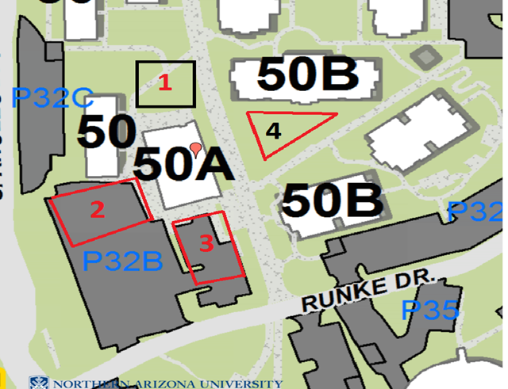
Site Selection
Synergy Engineering
Table 1: Items Considered for Site Selection
Items Considered | Considerations
 | Site 1 | Site 2 | Site 3 | Site 4
Differential site elevation (ft) | -10 | -2 | +2 | -15
Area of footprint (ft²) | 10,520 | 10,550 | 9,020 | 8,720-13,190
Existing site utilities | Relocate detention basin, EL, 2WLs | Relocate EL and 2WLs | Relocate EL | Need no relocations
Connection to existing building | We look at the existing pathway and facilities.
Relocation of sidewalk | We look at the existing sidewalk on the map.
Removal of tress | 11 | 0 | 10 | 9
Parking Spaces Taken | 0 | 20 | 22 | 0
Int’l Pavilion
N
Figure 2: International Pavilion and Four Sites
Notes:
Not sure how to make this look better

Slide 6
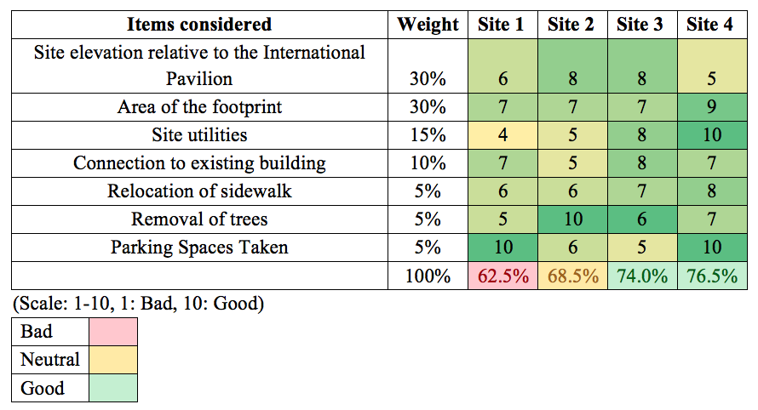
Site Selection Cont.
Synergy Engineering
Table 2: Decision Matrix for Site Selection

Slide 7
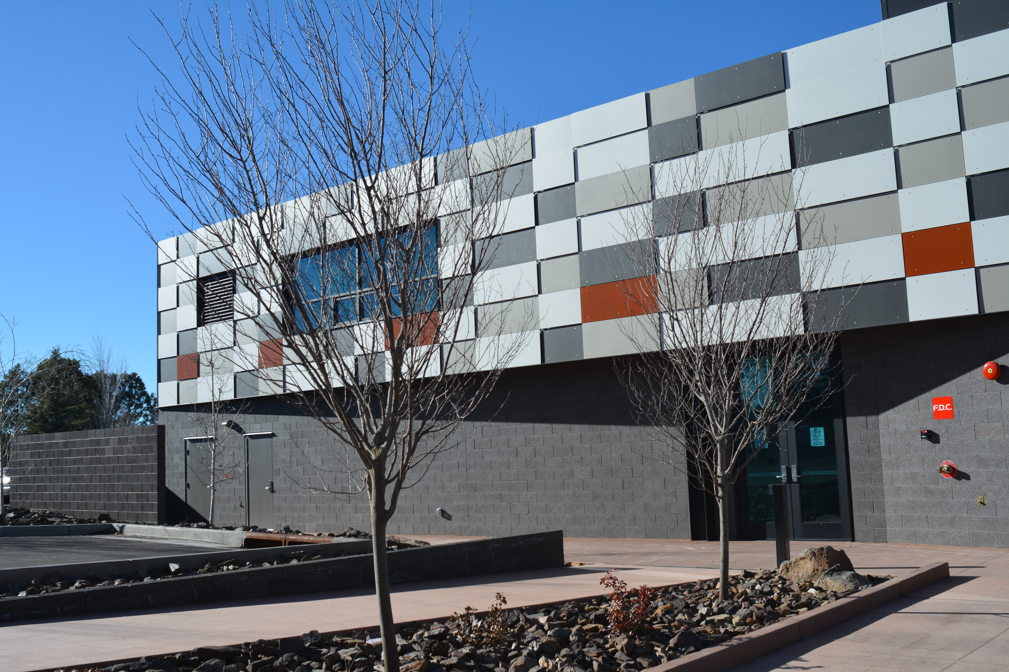
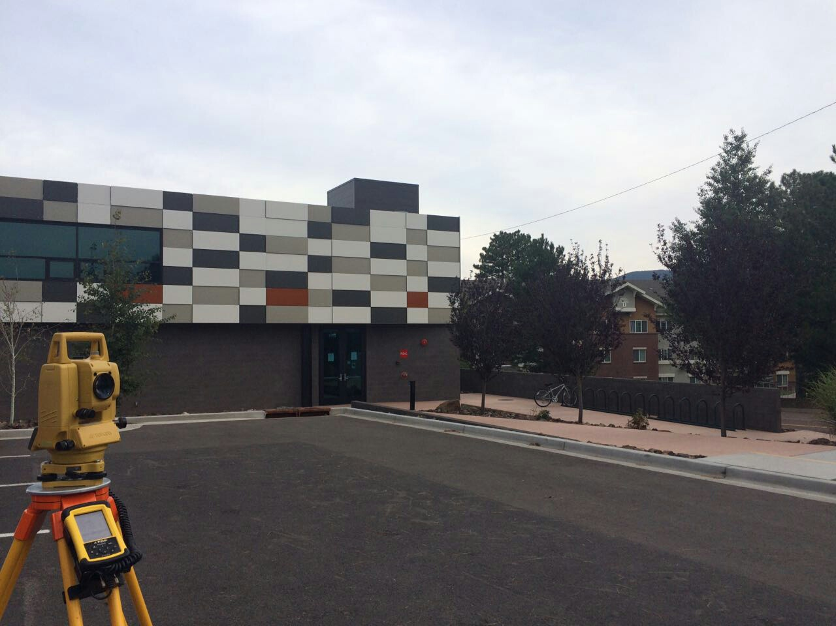
Site Selection Cont.
Synergy Engineering
Relatively small elevation changes
Close to the existing building
Rectangular shape for a maximum use of space
Least disruptive to existing residents
Site 3 was selected by client
Figure 3 & 4: International Pavilion South Side View
Notes:
Add something on the empty space

Slide 8
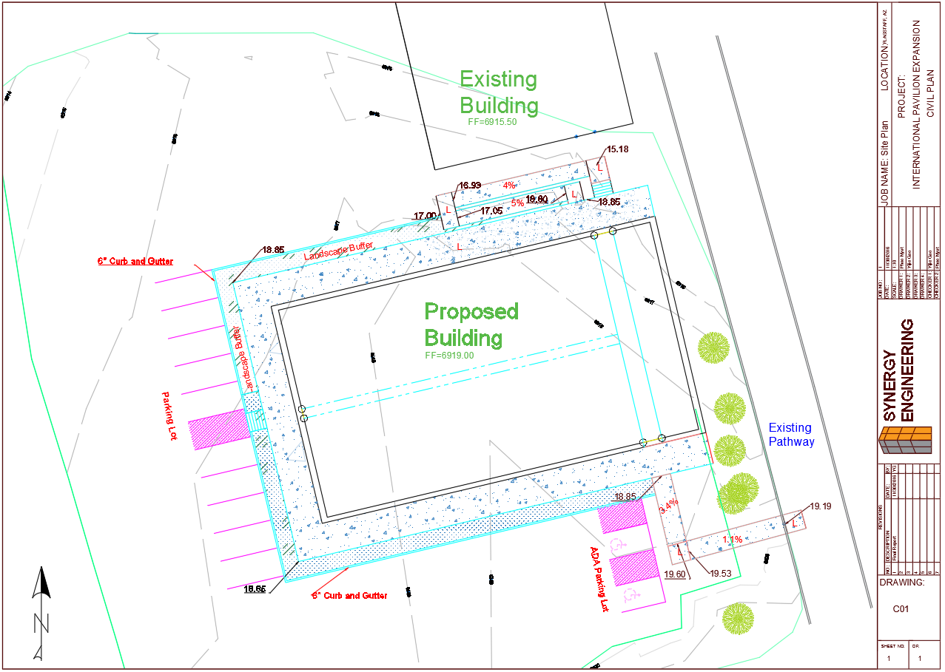
Civil Site Plan
Synergy Engineering
7
Notes:
Need to update

Slide 9
Proposed Building
Synergy Engineering
Design Principles
  Culture exchange
  Energy-saving building
    Sun: prevent summer heating and allow passive heating during winter
    Wind: natural ventilation
  Connection with existing building
  Have all necessary spaces
  Central innovative campus

Slide 10
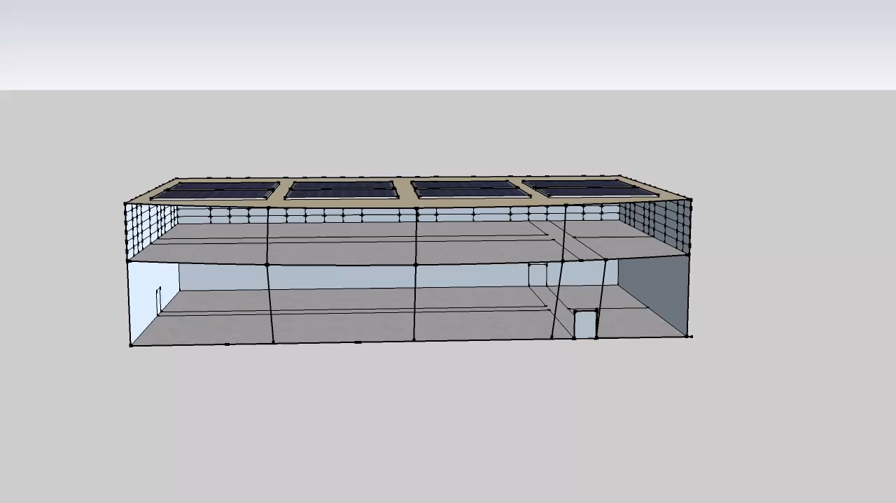
Proposed Building Shell
Synergy Engineering
Notes:
Need to make the video slower or add labels

Slide 11
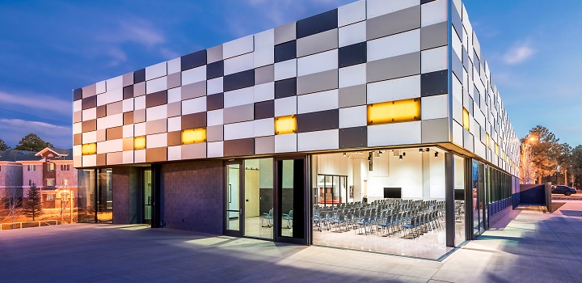
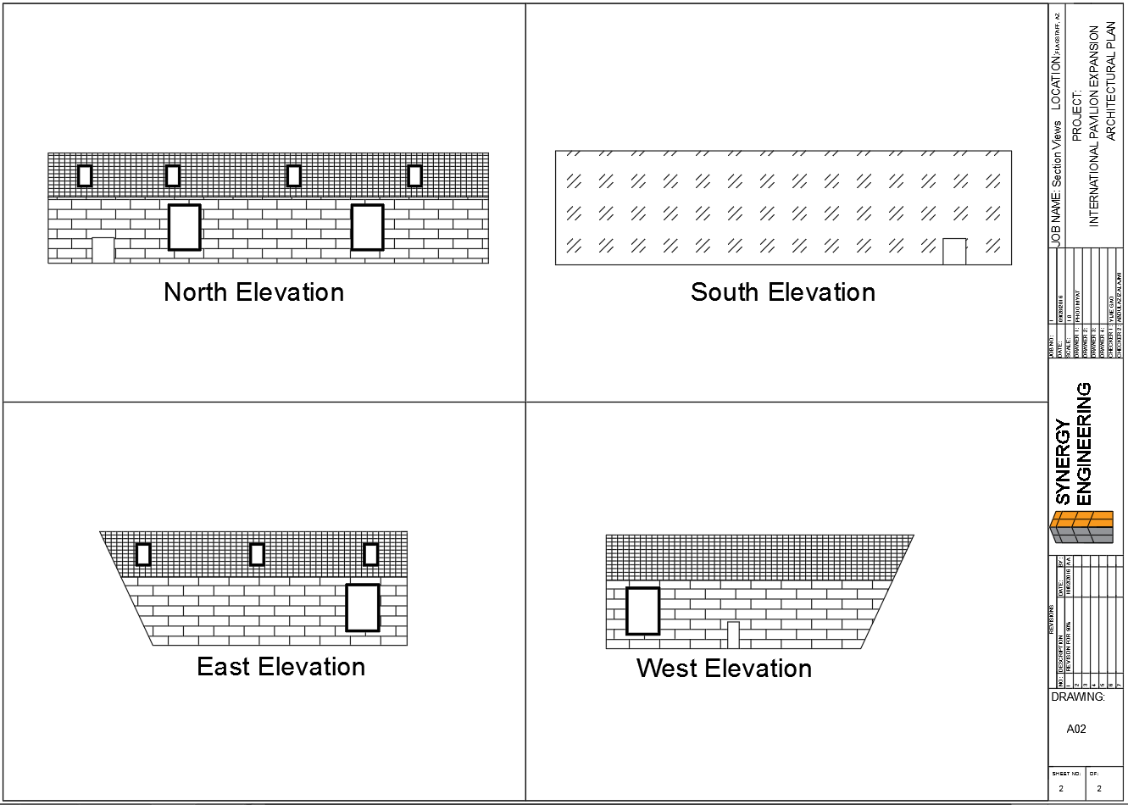
Building Section Views
Synergy Engineering
Figure 3: International Pavilion

Slide 12
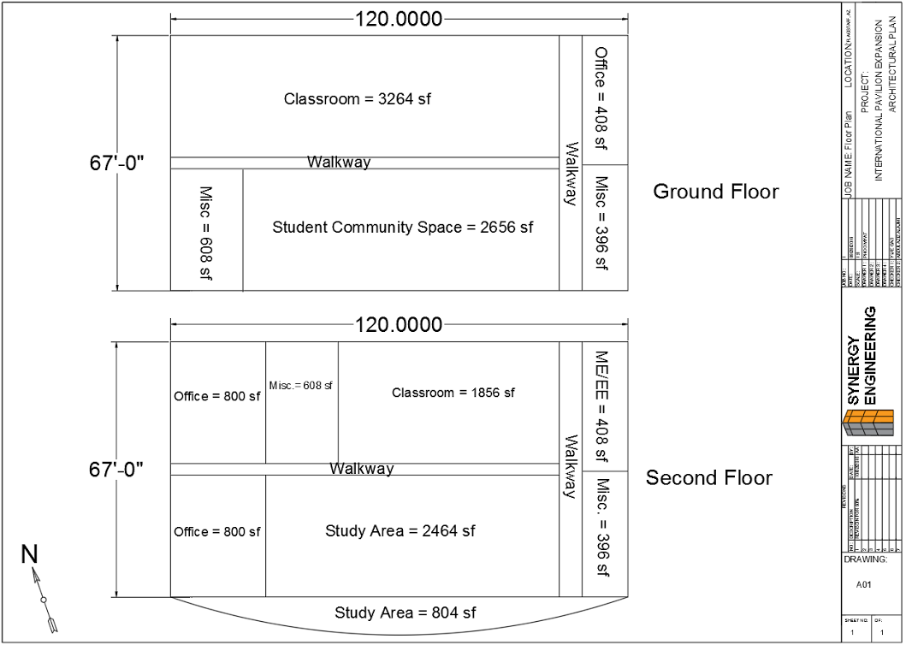
Building Layout
Synergy Engineering

Slide 13
Loads Calculations
Synergy Engineering
Gravity Loads
Lateral Loads
Dead Loads
  Self-weight of structural members
  Superimposed dead load
  Dead loads
  Total dead load: 200 psf
Live Loads
  Roof snow load: 40 psf per NAU Technical Standards
  Design live load: 100 psf
Wind
  ASCE 7-10 Simplified Directional Procedure
  Total wind load: 115.2 kip
Seismic
  ASCE 7-10 Seismic Procedure
  Total seismic load: 199.6 kip
12
Notes:
Need to change kip to psf

Slide 14
Structural Design Elements
Steel Roof Deck & Composite Floor Deck (Vulcraft)
Steel Roof Joists & Steel Floor Joists
Steel Roof Girders & Steel Floor Girders
Steel Columns
Steel Cross-bracing
Concrete Grade Beam
Concrete Footings
Loads & Assumptions
13
Notes:
Roof & Floor Decks
Roof & Floor Joists
Roof & Floor Girders
Columns
Cross-bracing
Concrete Footings
Concrete Grade Beam

Slide 15
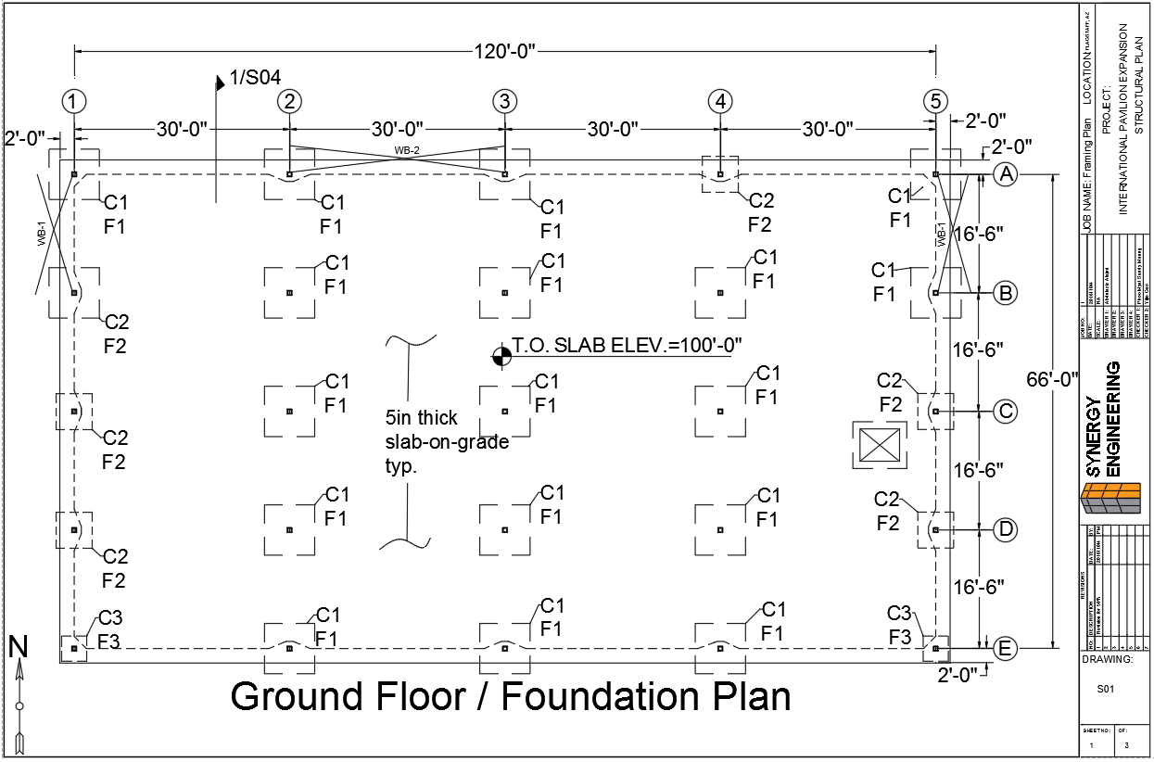
Foundation Plan
Synergy Engineering
C: Column, F: Footing
14

Slide 16
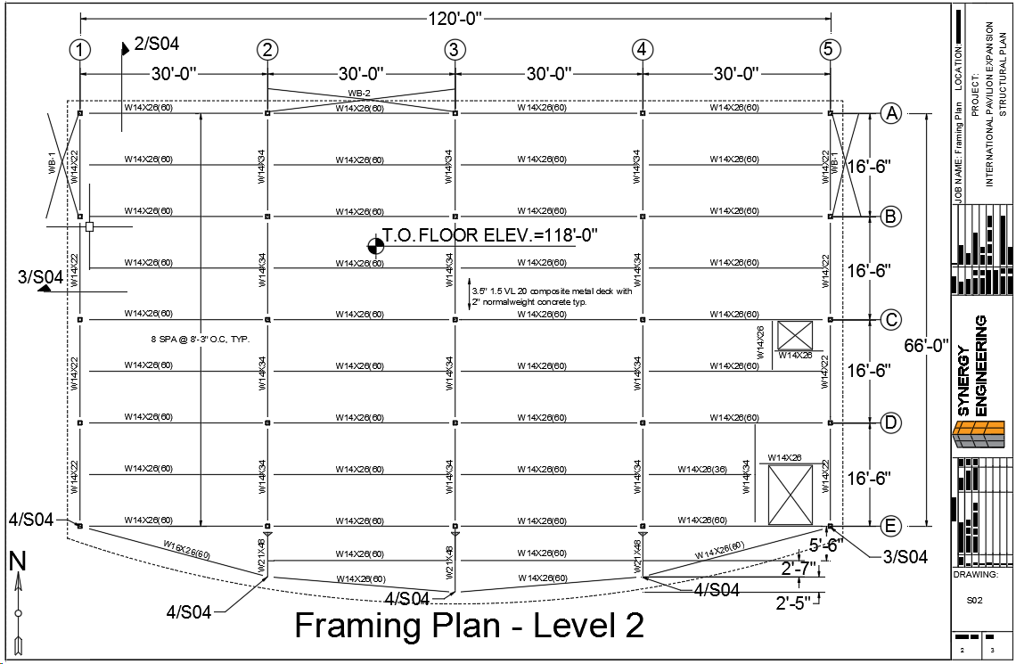
Second Floor Plan
Synergy Engineering
15
Notes:
Need to capitalize “level”

Slide 17
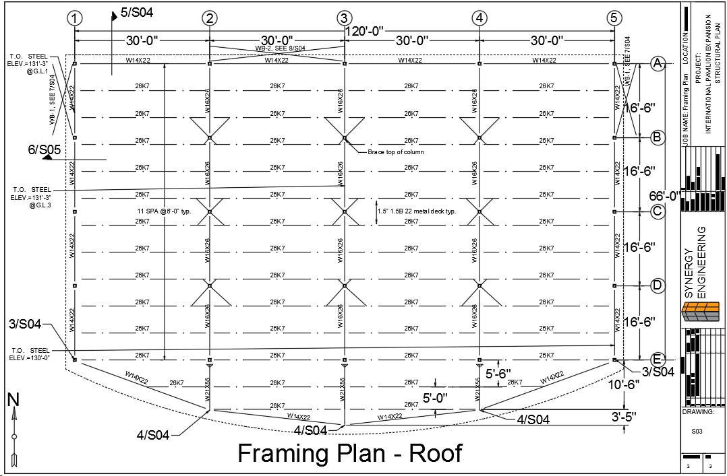
Roof Plan
Synergy Engineering
16

Slide 18
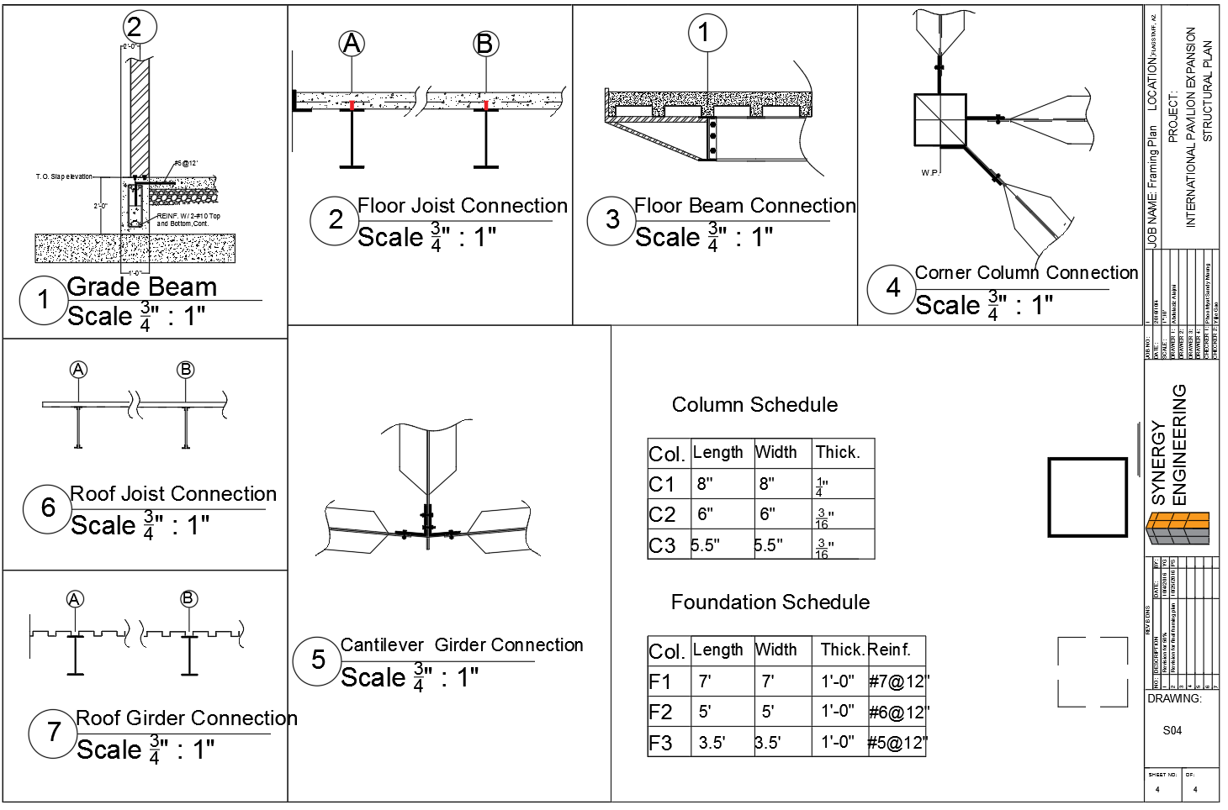
Structural Details
Synergy Engineering
17
Notes:
Need to change number order
Need to change color

Slide 19
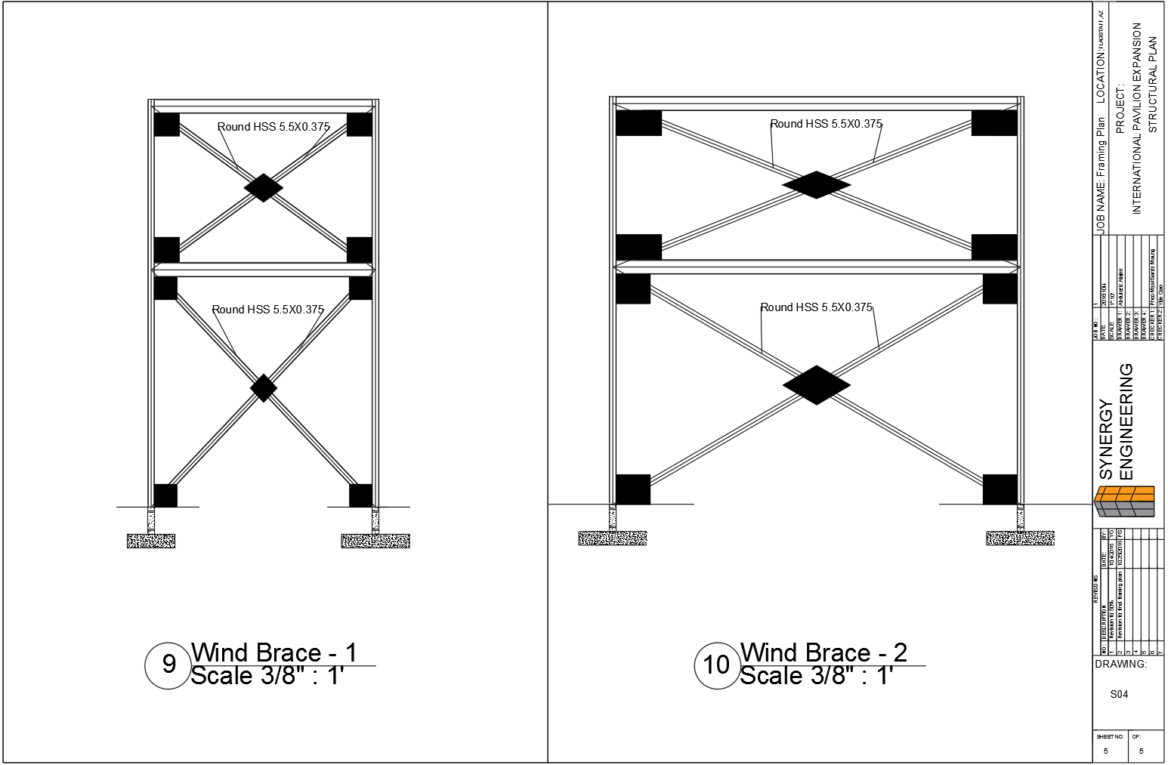
Structural Details
Synergy Engineering
18
Notes:
Need to change number order
Need to change color

Slide 20
Construction Cost Estimate
Synergy Engineering
 | Total Cost
Division 1: General requirements | $150,000
Division 2, 31-33: Sitework | $285,215
Division 3: Concrete | $193,262
Division 4: Masonry | $123,050
Division 5: Metals | $389,395
Division 6: Wood and plastics | $16,400
Division 7: Thermal and moisture protection | $183,354
Division 8: Doors and windows | $276,400
Division 9: Finishes | $356,426
Division 10: Specialties | $20,000
Division 14: Conveying systems | $65,000
Division 21-26: MEP | $1,267,366
Total: $3,325,869
Notes:
Divsions are per CSI 50.

Slide 21
Construction Cost Estimate Cont.
Synergy Engineering
 | Total Cost
Total construction cost | $3,325,869
Contingency (15%) | $498,880
General conditions | $475,220
Tax, insurance, bond, and markup | $587,554
Total cost | $4,887,523
Square feet cost | $289
Notes:
Conceptual estimate

Slide 22
Cost of Engineering Services
Synergy Engineering
Total Cost of Engineering Services
Service | Estimated | Actual | Estimated Cost | Actual Cost
1.0 Personnel | 682 Hours | 576 Hours | $82,160 | $82,233
2.0 Surveying Equipment Rental | 10 Hours | 10 Hours | $200 | $200
3.0 Travel | 288 Miles at $0.5/mile | 0 | $144 | 0
4.0 Code and Standards Purchase |  |  | $600 | $600
 |  | Total cost | $83,104 | $83,033
 |  | Cost % difference | 0.085%
21

Slide 23
Impacts
Environmental
Renewable energy (solar and wind)
Potential tree removal
Economic
Provide jobs for the students and general public
Societal
Promote culture exchange
Event spaces for the university
22

Slide 24
Acknowledgement
Technical Advisors
  Dr. Robin Tuchscherer
  Prof. Kai Kaoni
Professor Alan Francis
Meyer Borgman Johnson Engineering
  Mr. Kurt Kindermman
  Mr. Nick Yuen
Peak Engineering
  Mr. Sam Heffelfinger
Grading Instructor: Dr. Bridget Bero
23

Slide 25
References
Synergy Engineering
[1] “NAU International Pavilion”, nau.edu, 2016. Available: https://nau.edu/cie/international-pavilion/
[2] Northern Arizona University, Interactive Campus Map, 2016.
[3] International Building Code, 2012.
[4] NAU Technical Standards, 2016.
[5] The City of Flagstaff Code, 2012.
[6] Minimum Design Loads for Buildings and Other Structures, 2010.
[7] Vulcraft, 2016.
24

Slide 26
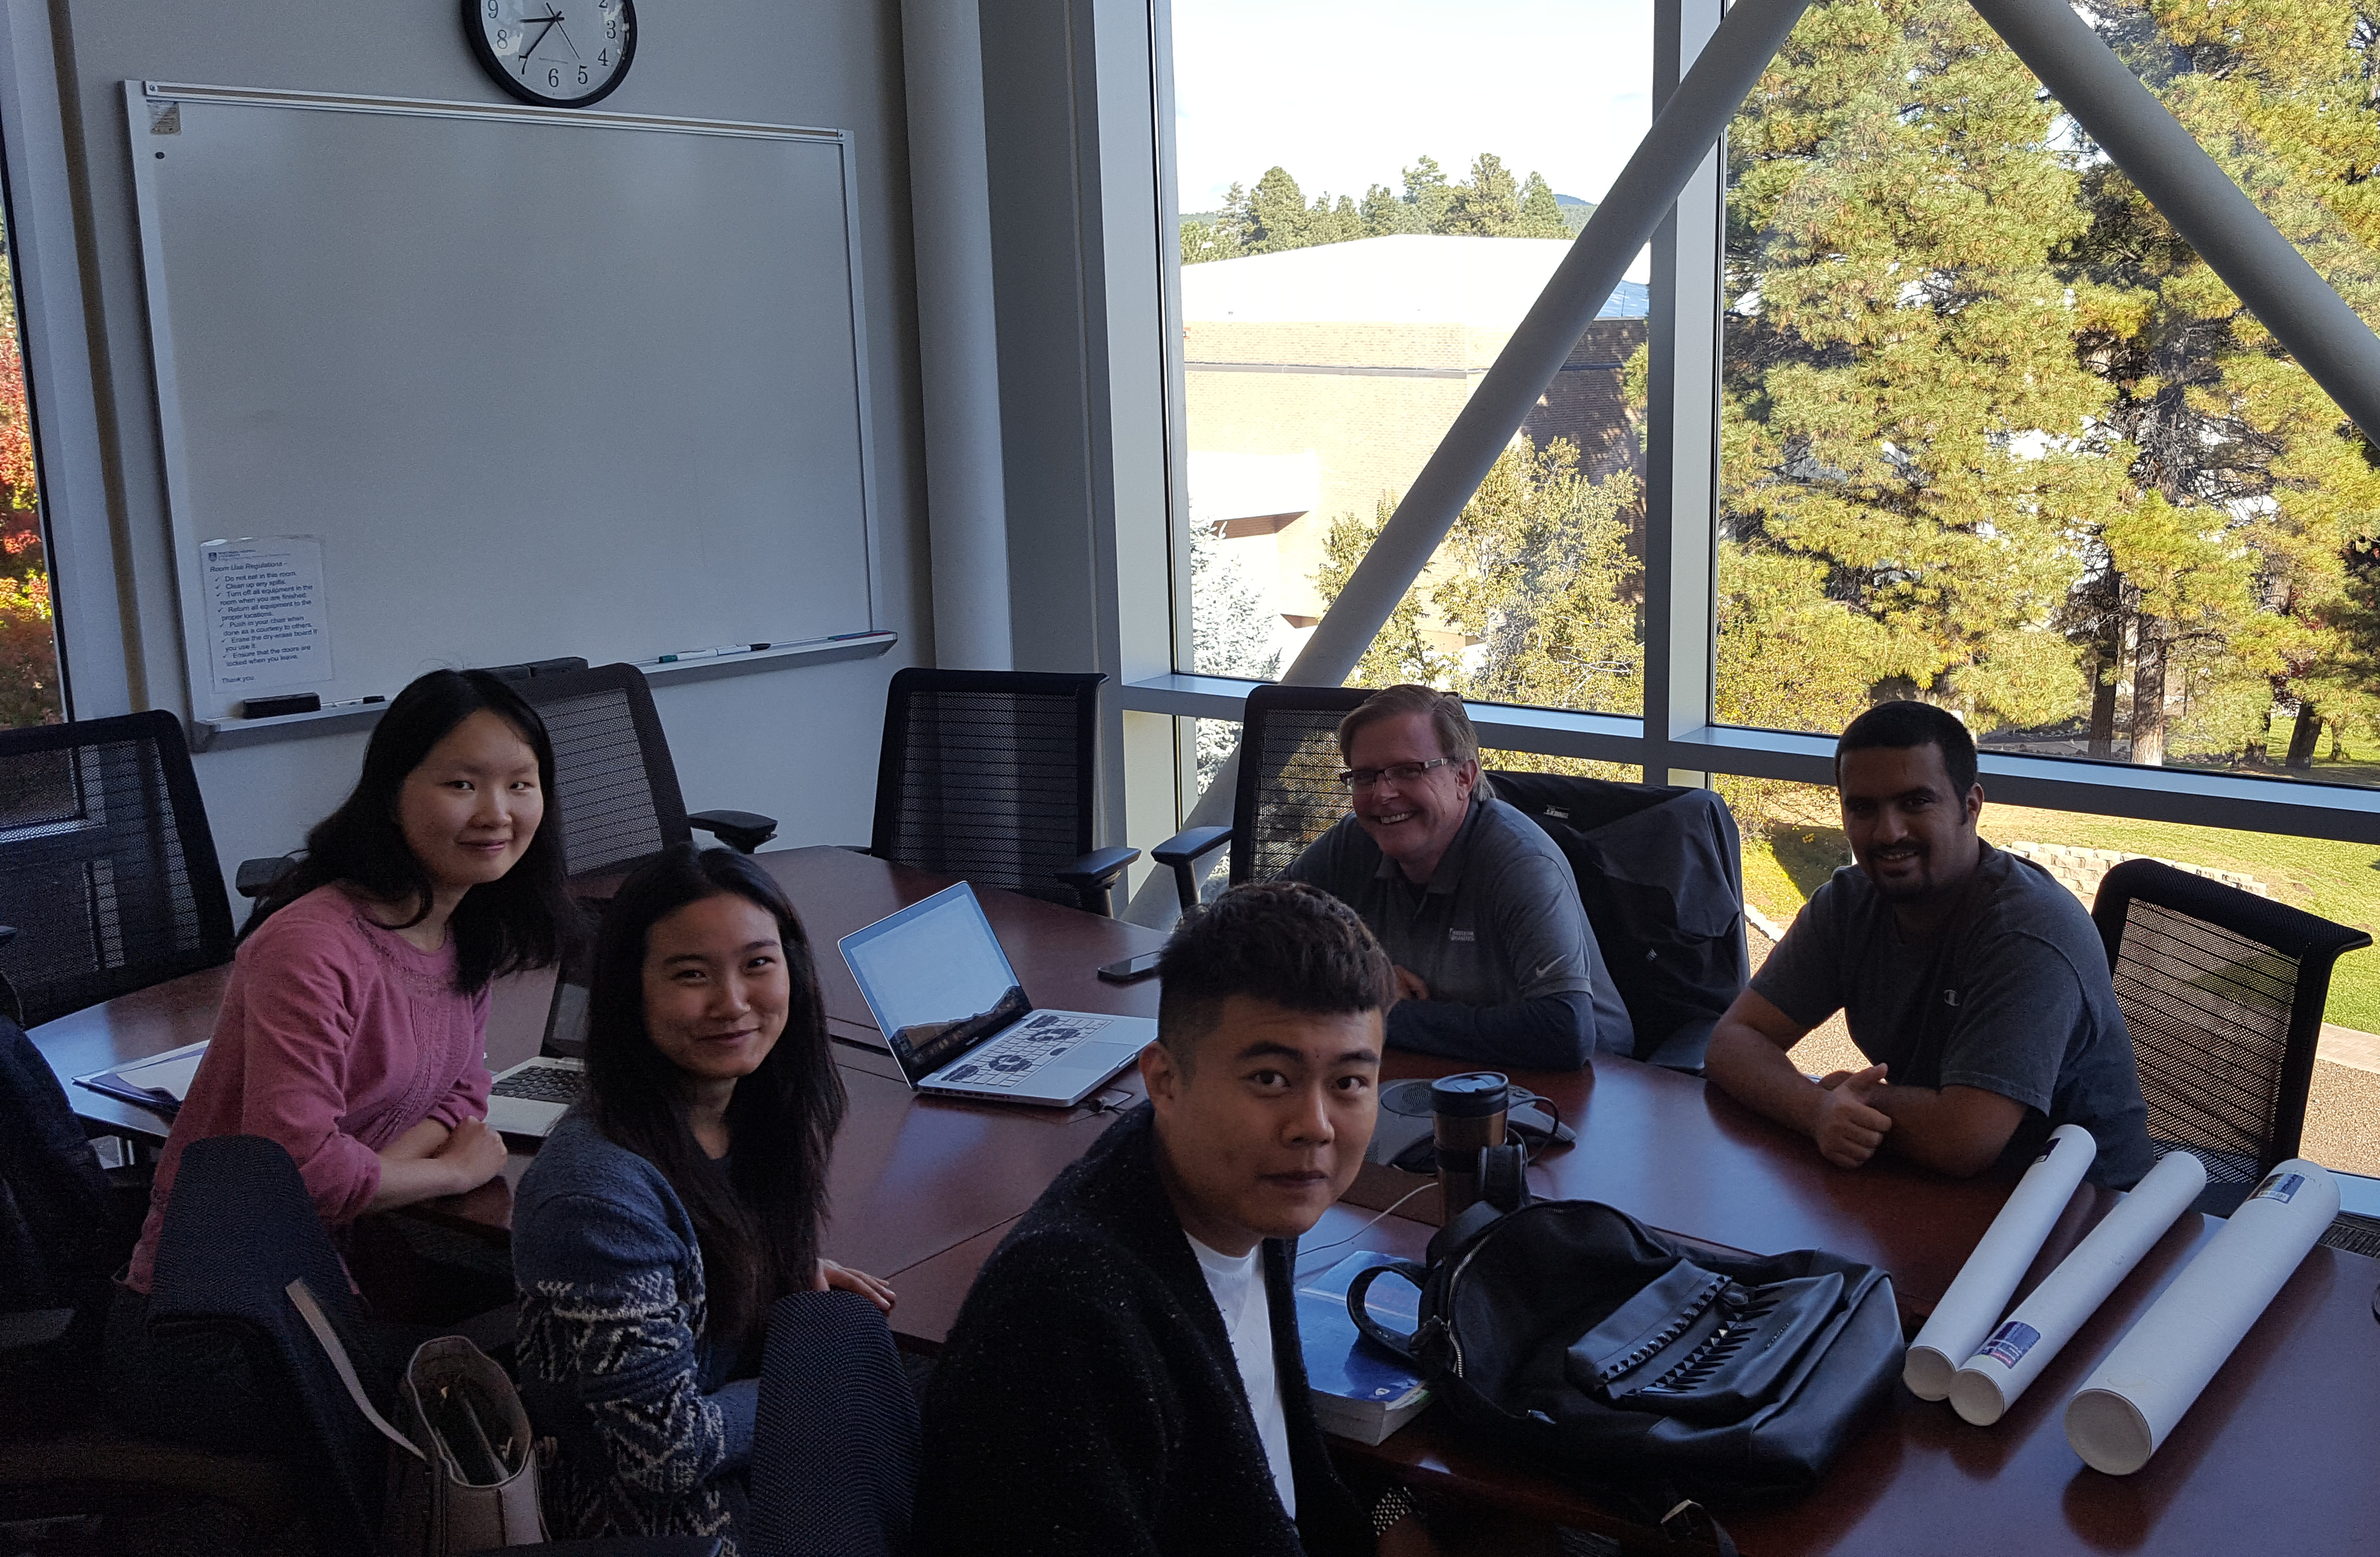
THANK YOU!
Synergy Engineering
25

